Slide 1
EUROPEAN COMMISSION HORIZON 2020
Project Overview

Slide 2
WHAT IS FASTER?
Twinning Project funded by the European Commission (Directorate General for Research and Innovation) through the Horizon 2020 funding programme (810812).
Main objectives
Strengthening the capacities and position of 3 Tunisian institutions (INRGREF, IRESA and AVFA) reaching excellence in research and consolidating international quality standards in project proposals.
Focus of the project
Innovative land and water management for improved adaptation and mitigation of climate change in the agricultural sector.
Overall mission
To share the knowledge and experience of EU partners with established scientific excellence in the topic.
Structure: 6 Work Packages
Duration: 3 years (2018-2021)

Slide 3
CHALLENGES FASTER AIMS TO TACKLE
Improving the research excellence
of Tunisian partners
Boosting institutional networking and international reputation of INRGREF
- 5 multidisciplinary training activities
- 5 research training activities
9 specialized training activities
Work table on specific subject development
At least 9 short term staff exchanges
Mapping of current and potential international alliances and initiatives in which INRGREF can be engaged in
Communication and stakeholder engagement
Engagement in at least 6 international relevant research events
Engagement in at least 6 international info days.
Production and dissemination of a
video-documentary
Developing a knowledge transfer framework to engage Tunisian entities and third parties
Supporting FAS sustainability in Tunisia
List of indicators of excellence for Tunisian research.
Guidelines on new research avenues and approaches
Governmental agreement for the support of research excellence
Job bank for FAS young professionals.
Mapping of current and potential business alliances and initiatives
Operational living lab on FAS services
Summer school program for young technicians
Multi-stakeholder platform
E-learning course for FAS technicians
FAS database and networking tool

Slide 4
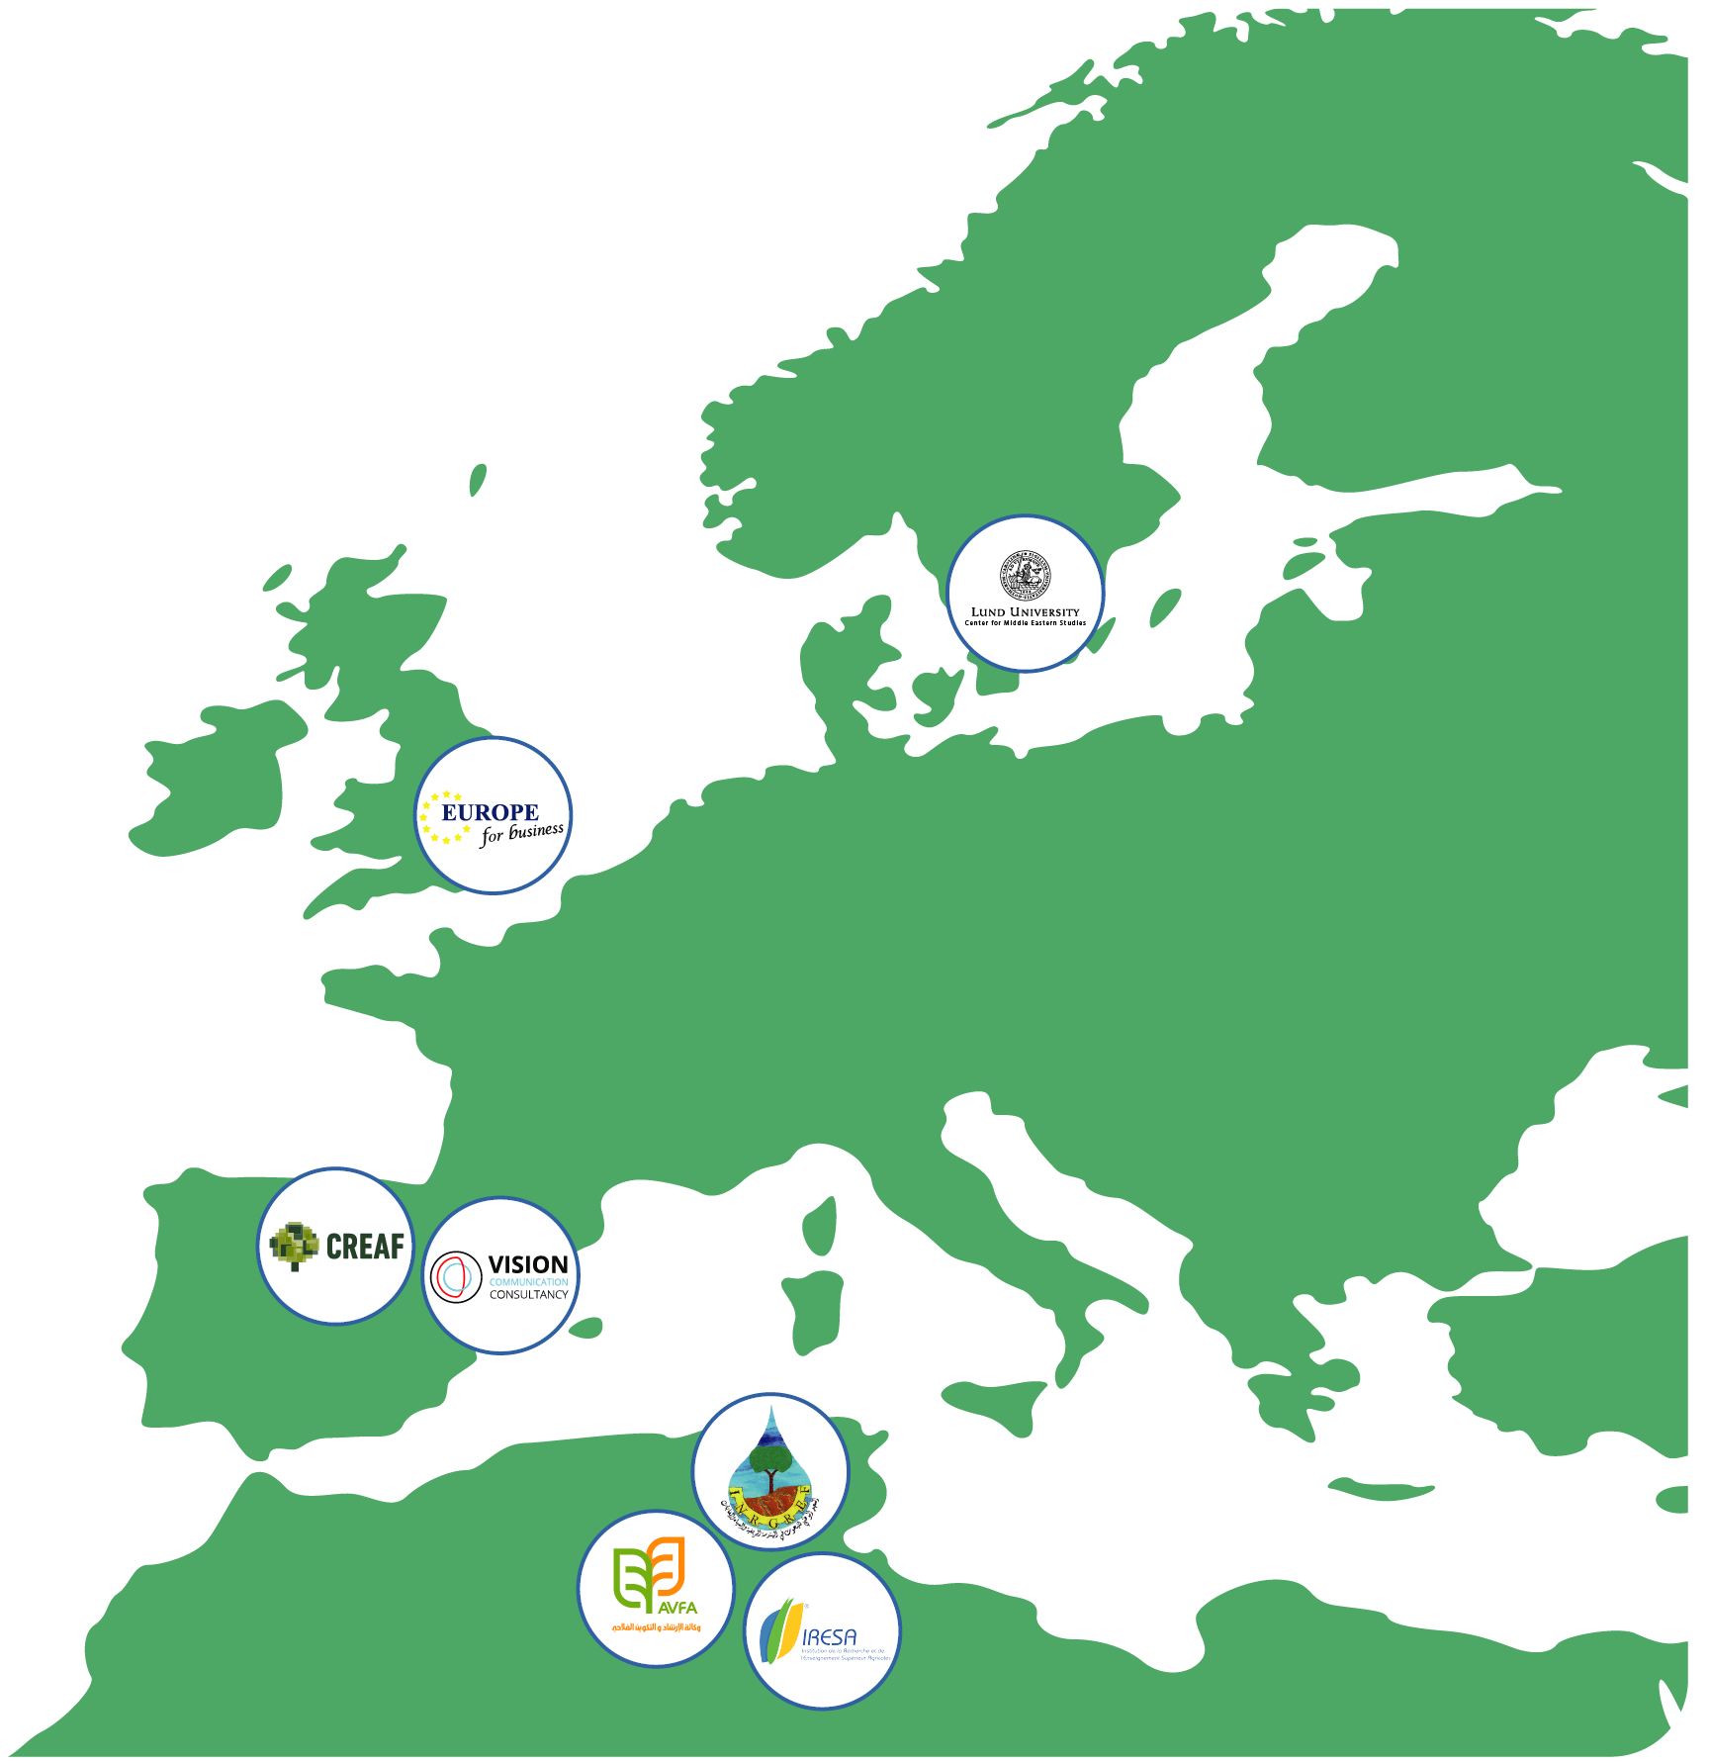
PARTNERS
Participant organization
Short Name
National Research Institute of Rural Engineering, Water and Forests
http://www.inrgref.agrinet.tn
INRGREF
(Coordinator)
Creaf
http://www.creaf.cat
CREAF
Lund University
https://www.lunduniversity.lu.se
LU
Europe for Business
http://www.e4business.eu
EFB
Vision Communication Consultancy
https://vision-communication.org
VISION
Agence de la Vulgarisation et de la Formation Agricoles
http://www.avfa.agrinet.tn
AVFA
Institution de la Recherche et de l'Enseignement Supérieur Agricoles
http://www.iresa.agrinet.tn
IRESA

Slide 5
PROJECT OBJECTIVES
Increase the research excellence of INRGREF
Support the institutional networking
and international reputation of INRGREF
Develop a knowledge transfer framework
Support FAS sustainability in Tunisia
Including
Increase the research excellence of INRGREF in land and water management to face climate change
Enhance the reputation, attractiveness and networking channels of INRGREF
Improve INRGREF capability to compete successfully for national, EU and international research funding
Illustrate quantitatively and qualitatively the expected impacts of the project by concrete indicators
Improve the access to research avenues, development of new approaches and increased mobility of qualified scientists.

Slide 6
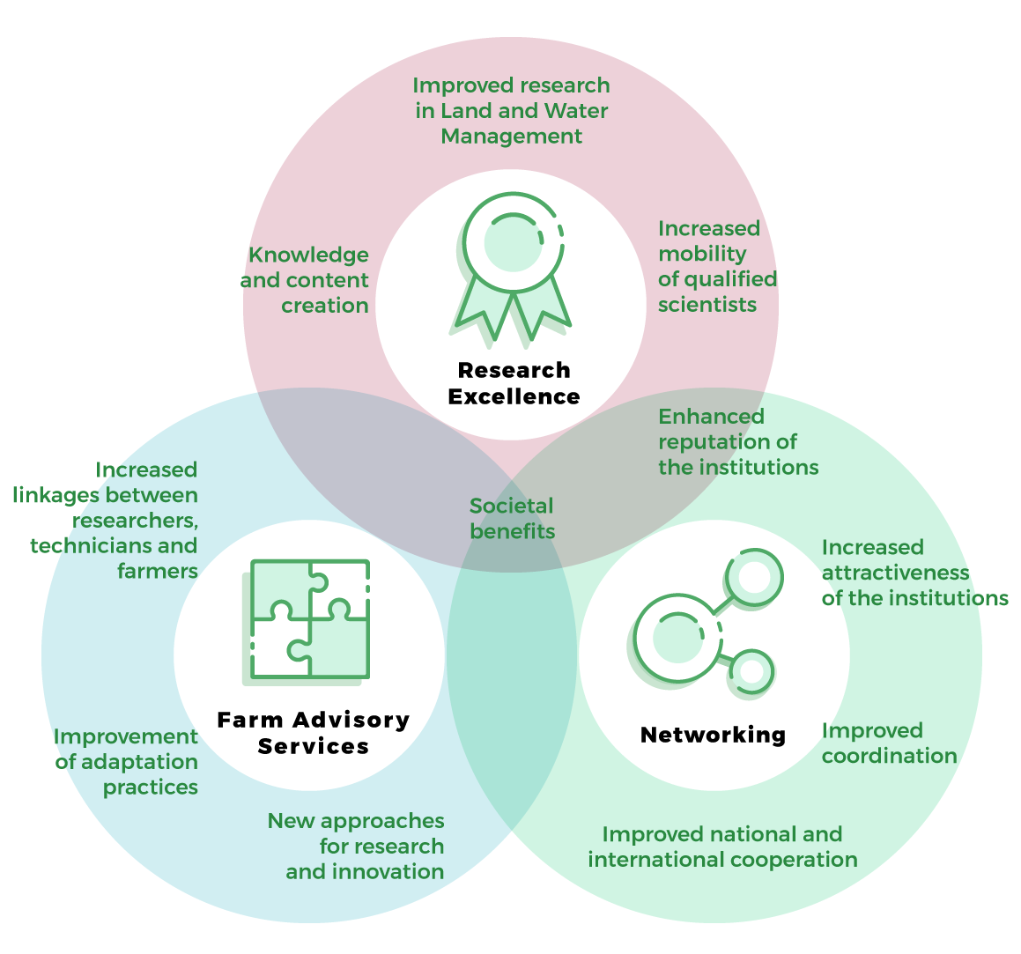
EXPECTED IMPACTS

Slide 7
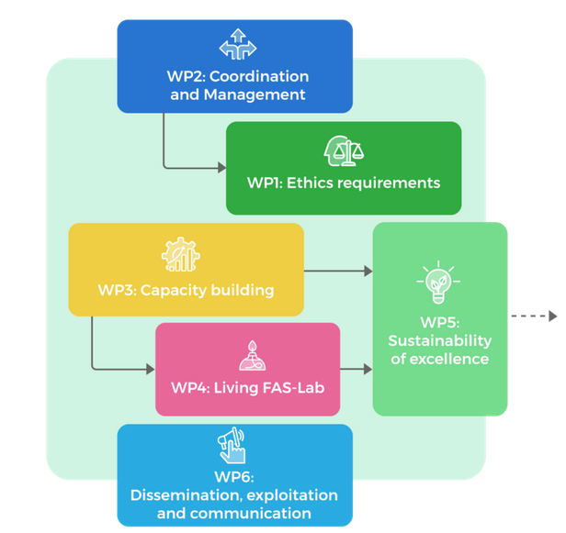
FASTER WORK PACKAGES

Slide 8
FASTER WORK PACKAGES
WP 1 – Ethics Requirements
Objectives: Moral principles that govern a person's behaviour or the conducting of an activity. This work package sets out the 'ethics requirements' that the project must comply with.
4 Deliverables

Slide 9
FASTER WORK PACKAGES
WP2 – Coordination and management
Objectives: effective management of the project, coordination between participants, efficient exchange of information with the project team and a communication channel for the EC.
Description of tasks:
Task 2.1 Overall management of the project [INRGREF] (M1-M3)
Periodical review of the time schedule with participants
Task 2.2 Quality Assurance [EFB] (M1-M36)
Project results, deliverables and key events will be supervised internally.
Task 2.3 Organization of the project meetings [INRGREF] (M1-M36)
Steering Committee Meetings, held twice a year, etc.
Task 2.4 Networking with other initiatives [CREAF] (M1-M30)
Guarantee communication and coordination with other EC projects, with FAS committees,
7 Deliverables

Slide 10
FASTER WORK PACKAGES
WP3 – Capacity Building
Objectives: Increase development of the human resources and build capacity of scientific staff within INRGREF.
Description of tasks:
Task 3.1 Evaluation of multidisciplinary needs for research excellence [Vision]
5 key cross-cutting and multidisciplinary training activities; Development capacities in understanding, managing and operating at international standards levels
Task 3.2 Research excellence tools [CREAF]
5 research excellence training courses providing knowledge and increasing performance indicators
Task 3.3 Mobility programme [LU] (M1-M33)
Short term visits of staff, PhD student projects, co-authoring publications, development of collaborations
Task 3.4 Specialized training [CREAF and LU] (M11-M24)
on adaptation to climate change in land and water management, including innovative governance - 9 courses.
8 Deliverables

Slide 11
FASTER WORK PACKAGES
WP4 – Living FAS-Lab
Objectives: To set up one living lab in order to test specific FAS solutions and to put into practice state-of-the-art knowledge on adaptation to climate change in land and water management
Description of tasks:
Task 4.1 Creation of local Living Lab [INRGREF, CREAF] (M6-M36)
Task 4.2 Summer school program for young technicians on FAS
Task 4.3 Multi-stakeholder platform for improving FAS services [CREAF, AVFA] (M12-M30)
Task 4.4 E-learning FAS to technicians [EFB, CREAF] (M18-M30)
Task 4.5 Production of fact sheets and video tutorials on concrete solutions [CREAF/Vision] (M6-M33)
9 Deliverables

Slide 12
FASTER WORK PACKAGES
WP5 – Sustainability of excellence
Objectives: Provide the necessary monitoring, network, guidelines, support and tools to maintain the achievements in excellent research. Such framework will allow INRGREF and associated centers to step-up and continue growing
Description of tasks:
Task 5.1 Indicators of excellence [CREAF and LU] (M18-M24)
Task 5.2 Institutional networking [LU and CREAF] (M18-M36)
Task 5.3 Finding new research avenues and approaches [CREAF and LU] (M24-M36)
Task 5.4 Governmental Support to extension services [AVFA] (M30-M36)
Task 5.5 Job Bank for FAS young professionals [EFB] (M18-M36)
6 Deliverables

Slide 13
FASTER WORK PACKAGES
WP6 – Dissemination, exploitation and communication
Objectives: Implement a series of measures designed to maximise the outreach for the project results and network activities, to maximise the input from the community, and to train practitioners fostering the transfer of knowledge and enhance their professional development.
Description of tasks:
Task 6.1 Project outreach, engagement and positioning strategy [Vision] (M1-M36)
Task 6.2 Dissemination program for project activities [Vision and INRGREF] (M1-M6)
Task 6.3 Spreading excellence [Vision] (M6-M30)
Task 6.4 FAS database and networking [Vision] (M18-M36)
8 Deliverables

